Slide 1







P R E S E N T A T I O N 2 0 2 6
Workforce Longevity: Designing Data-Led Strategies
Retention
Student Name
Anamika Shah
Mentor Name
Ms. Umamaheshwari
Student Email
annexi.mika@gmail.com

Slide 2
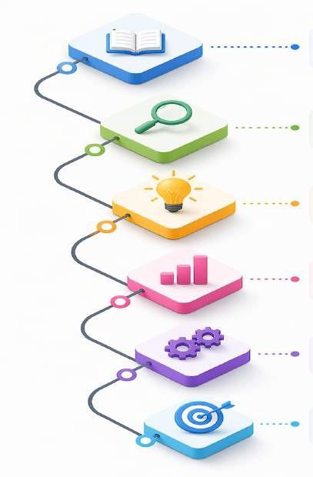
Outline
Abstract of the Project
Problem Statement
Proposed Solution
System Architecture
Live Demo of the Project
Embedded Video of Project
Conclusion
Future Scope

Slide 3
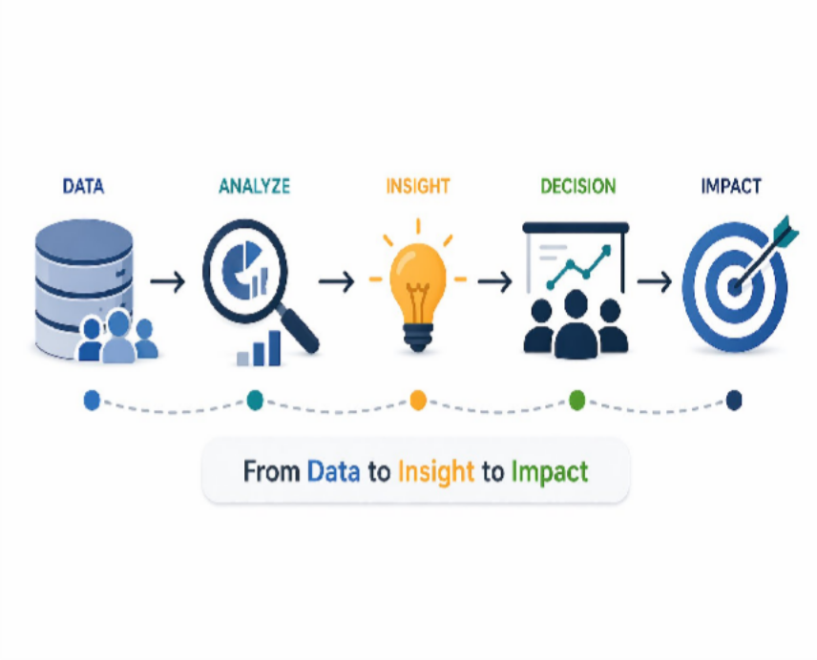
Abstract
This project
develops
a data-driven employee
retention framework
using HR analytics and
Power BI to address attrition.
Using the IBM HR dataset, it identifies key drivers like job satisfaction, overtime, salary, and tenure.
Through data cleaning, KPI development, and dashboard visualization, insights are generated from raw data.
The outcome is an executive dashboard that supports proactive, data-driven workforce decisions.

Slide 4

Problem Statement
Entry of younger workforce segments has shifted workplace expectations, increasing attrition in rigid work environments.
High employee turnover impacts productivity, workforce stability, and increases hiring and training costs.
Current HR practices are largely reactive and fail to address evolving needs like flexibility, purpose, and continuous feedback.
Lack of structured data analysis, KPI tracking, and segment-based insights limits proactive decision- making and retention strategies.

Slide 5
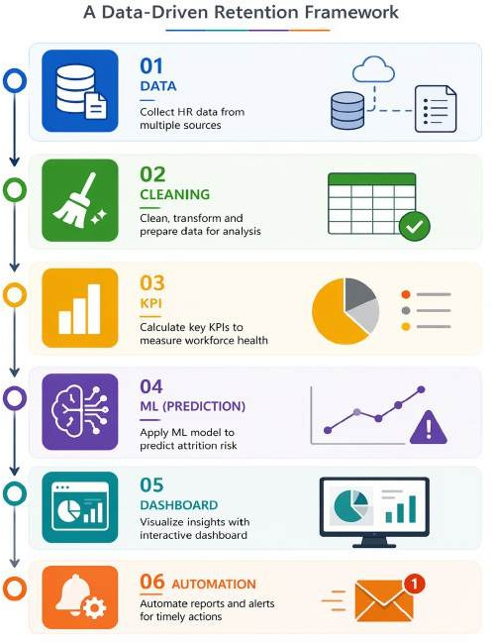
Proposed Solution
Designed a data-driven retention framework for proactive workforce decision- making
Performed data cleaning and developed key KPIs for structured analysis
Identified major attrition drivers such as satisfaction, overtime, salary, and tenure
Built a Power BI dashboard with automated reporting using Zapier
Applied Azure ML to predict employee attrition risk

Slide 6
System Architecture
Data Input / Source
Processing / Analysis
IBM HR Analytics Employee Attrition dataset from Kaggle
Contains employee demographics, job roles, salary, satisfaction, and attrition status
Data cleaning and preprocessing using Excel and Power BI
KPI calculation using DAX (Attrition Rate, Tenure Groups, Salary Bands)
AI / Tool Integration
Output / Dashboard
Power BI for visualization and dashboard creation
AI tools (ChatGPT / Copilot), Zapier, and Azure ML for insight generation, automation, and predictive analytics
Interactive Power BI dashboard with KPI cards and visualizations
Automated HR reporting using Zapier for real-time data updates and email alerts.

Slide 7
Live Demo of Project
Here's the list of some demo screenshots / features of the project:
Demo 1
EXECUTIVE OVERVIEW DASHBOARD
Demo 2
PREDICTIVE ANALYTICS USING AZURE ML
.
Demo 3
AUTOMATED HR REPORTING USING ZAPIER

Slide 8
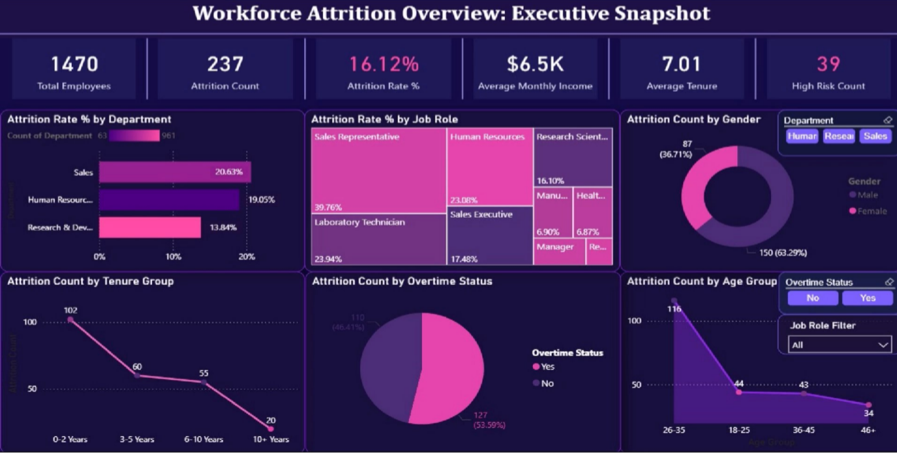
Demo 1

Slide 9
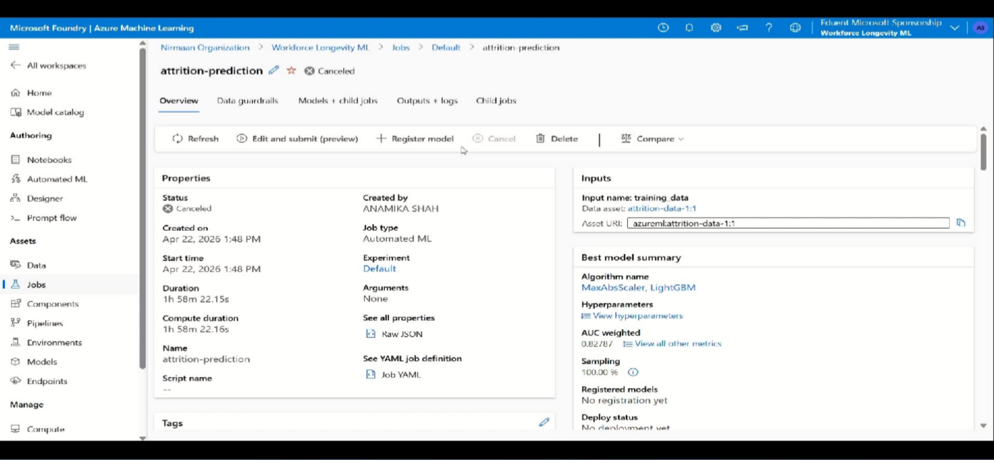
Demo 2
Azure ML Model Prediction

Slide 10
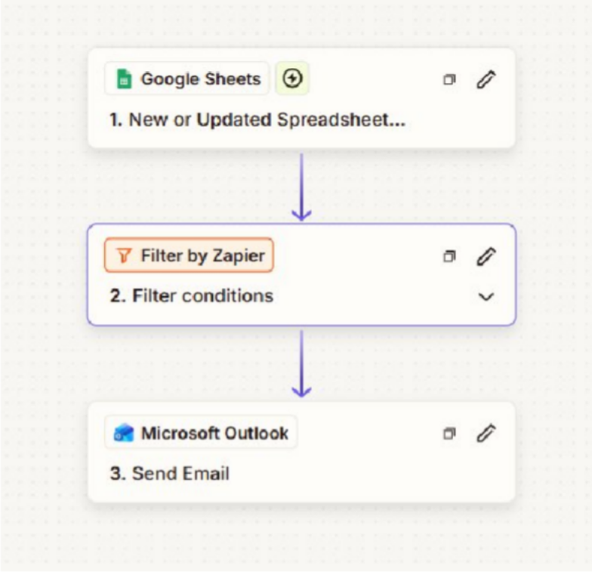
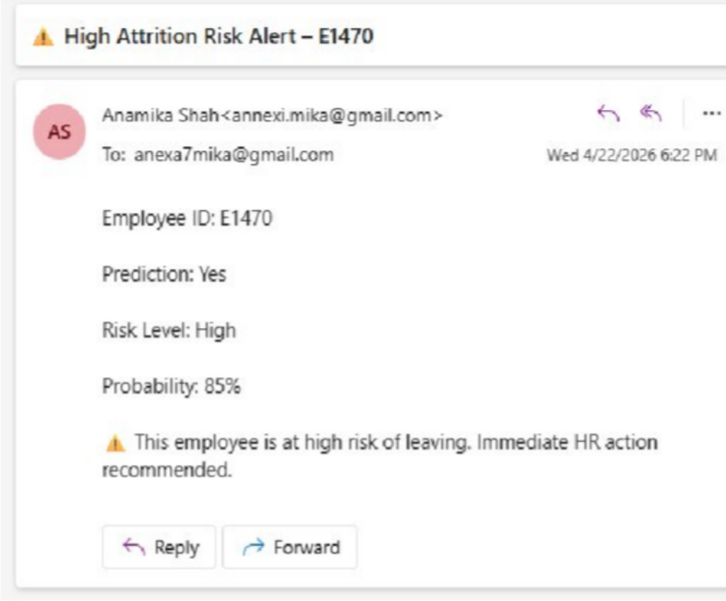
Demo 3
Automation Workflow
Automated Output

Slide 11
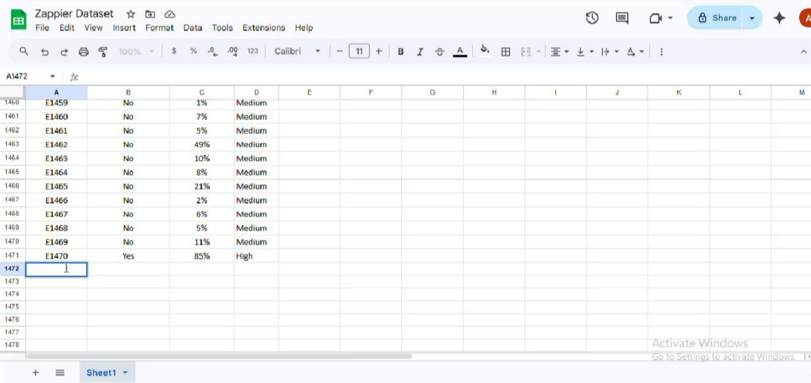



▶
Video of Project Demo
https://drive.google.com/file/d/18RTwT9amOEgWITevqfk46RwTOAW8Skhg/view?usp=drivesdk]
[Insert your project demo video.
You can embed a video your live project.]

Slide 12
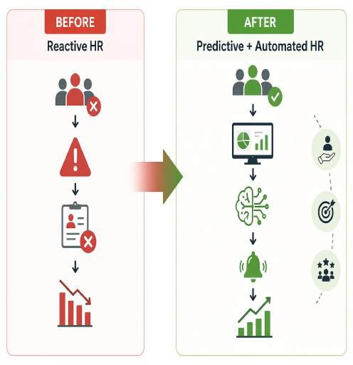
Conclusion
Attrition risk is highest among employees with low satisfaction, high overtime, and short tenure
Key challenges include workload imbalance, low engagement, and early-stage dissatisfaction
The dashboard identifies high-risk segments for targeted HR actions
Strategic steps like workload optimization, engagement, and compensation review can reduce attrition
Zapier enables automated reporting, while Azure ML predicts attrition risk for proactive decision-making

Slide 13

Future Scope
Integrate real-time HR data for continuous monitoring and insights
Apply predictive analytics to forecast employee attrition
Enhance dashboards with automated alerts for high-risk employees
Expand and scale the framework using additional workforce data and across industries

Slide 14
Thank You
A I C W F e l l o w s h i p | S t u d e n t P r o j e c t P r e s e n t a t i o n 2 0 2 6
LinkedIn | Edunet Foundation

